Slide 1
15.2 Exponential random graphs
Many networks we observe in the real world exist in only one instantiation
  Internet
  World Wide Web
Is the structure of such a network the only possible structure the network could have?

Slide 2
In some cases the questions we want to answer about the networked system can be tackled by studying the structure of only a single observed example
But there are cases where we would like to know about the entire set of possible networks that could represent a system
  Considerations of this kind lead us to consider ensemble models of networks

Slide 3

15.2.1 Definition of exponential random graphs
Suppose that we have some set of network measures whose numerical values are to be fixed
  Let the measures be x₁, x₂, …
Consider the set G of all simple graphs with n vertices and let us define the ensemble by giving each graph G a probability P(G) such that

Slide 4


The mean measure <x_{i}> is
Let us fix the mean value of each measure and ask what probability we need to assign to each graph. The question becomes
The number of measures is typically small and the number of graphs is large, if not infinite

Slide 5

Gibbs entropy
The best choice of probability distribution is to maximize the Gibbs entropy
The maximization of the entropy subject to the constraints on mean network measures can be solved by the method of Lagrange multipliers

Slide 6



The optimum is the set of values of P(G) that maximizes the quantity
Differentiating with respect to P(G) we get

Slide 7

Partition function and graph Hamiltonian
Z=exp(1-α) is called the partition function
H(G) is the graph Hamiltonian

Slide 8


It remains to find the values of Z and β_{i}
Z is determined by the normalization condition, which requires that
Thus,
The determination of β_{i} is problem dependent

Slide 9

15.2.2 Expectation Values
Once we have determined P(G), we can calculate quantities of interest within the ensemble
The expectation of quantity y in the ensemble is
This calculation gives us a “best estimate” of the value of y
  For instance, fixed the mean degree of the network, the methodology gives the best estimate of the degree distribution

Slide 10
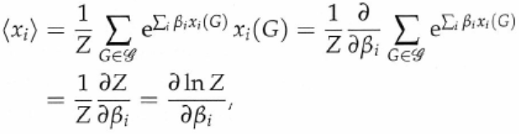

A special case is that y itself one of the set of network measures x_{i} that we have used to specify the ensemble
  Why doing this?
  The answer is that we still need to fix the parameters β_{i} and we do this by specifying the mean value <x_{i}>
  The quantity F=ln(Z) is called the free energy of the ensemble and

Slide 11


For general case, the trick is to introduce an extra term involving y into the Hamiltonian:
We now differentiate with respect to μ (at the point μ=0) to calculate the mean value of y

Slide 12
Some examples
G(n,m) random graphs
Configuration models
Reciprocity models
Two-star models
Strauss’s model of transitive networks

Slide 13
15.2.3 Simple examples
G(n,m) random graphs
Configuration models

Slide 14


The simplest example is the model in which we fix the expected number of edges in an undirected network only
Hamiltonian H=βm, where m is the number of edges
The ensemble probability and the partition function
A standard way to perform sum over graphs G is to sum over possible values of the elements A_{ij} of the adjacency matrix

Slide 15

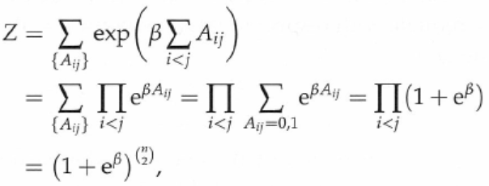

The number of edges in terms of the elements of the adjacency matrix
The partition function is
The free energy is

Slide 16


From , the average number of edges
To achieve a desired value of <m>, the value of β should be
Let p_{vw} be the probability that there is an edge between vertex v and vertex w
  p_{vw} is the mean of A_{vw}

Slide 17
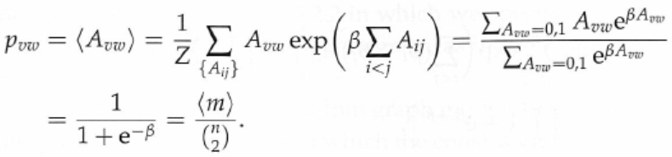

The probability of an edge between two vertices is uniform for all pairs of vertices
This model is just the ordinary Poisson random graph with

Slide 18


In the second example, we create a model with specified expected degree of each vertex within the ensemble
The graph Hamiltonian
Degrees in terms of the adjacency matrix

Slide 19
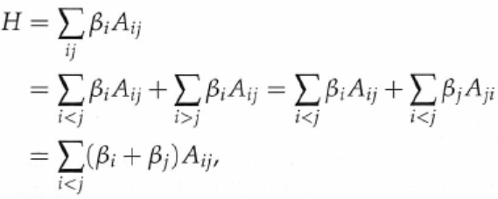
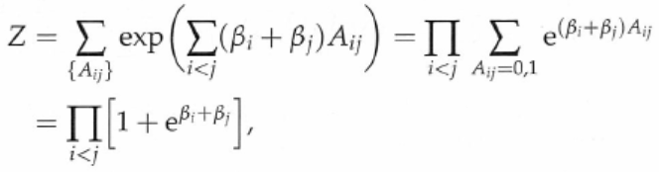
The Hamiltonian in terms of the adjacency matrix
The partition function

Slide 20
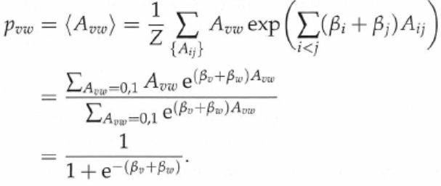

Probability of an edge between vertex v and vertex w is
This probability is now dependent on vertices v and w
In a sparse network, p_{vw} is much smaller than 1, which implies

Slide 21





The average degree is
Thus, where
Thus,
Since we require that thus,
This is the configuration model discussed in Chapter 13

Slide 22
15.2.4 Reciprocity model
In a directed network, if there is a directed edge from vertex u to vertex v and there is also an edge from vertex v to vertex u, we say the edge from u to v is reciprocated
  The reciprocity r is defined as the fraction of edges that are reciprocated
We create an exponential random graph model by fixing the expected number of reciprocated edges

Slide 23

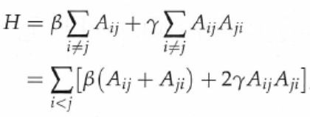
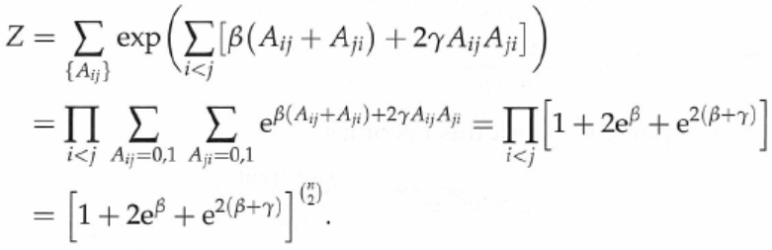
The number of reciprocated edges m_{r} is
We fix the number of edges and the number of reciprocated edges
The partition function

Slide 24

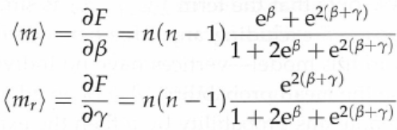

The free energy
The expected degrees
The reciprocity

Slide 25

15.2.5 Two-star model
In this model, we specify the expected number <m> of edges in the network and the expected number <m₂> of two-stars (or connected triples)
  The two-star model allows us to control the “clumpiness” of the network, the extent to which the edges gather together in clumps

Slide 26
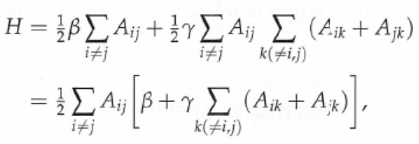
The Hamiltonian

Slide 27
Mean-field theory
Mean-field theory is a technique developed in statistical physics
Mean-field theory replaces state variables in the system dynamic equations by their corresponding mean values
  Replace the entries of the adjacency matrix in the Hamiltonian by their corresponding mean values

Slide 28
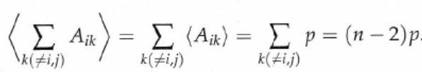

The Hamiltonian

Slide 29
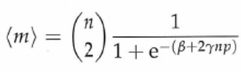


This is the same Hamiltonian for the ordinary Poisson graph with β replaced by β+2γnp
  We can reuse the partition function and other quantities of the previous section
  The average number of edges is
  The average number of edges is linked to the edge probability by and thus

Slide 30

Let us define B=β/2 and C=γn/2 and we have
There is no close-form solution for the above equation
However, one can study the structure of the solution using a graphical method

Slide 31
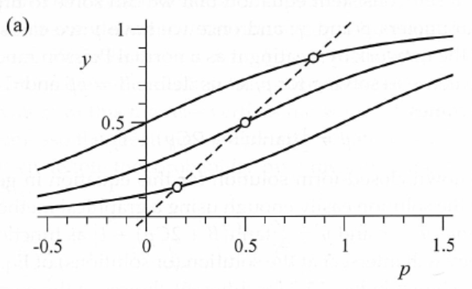
Plot of y=p and
C=1/2 and three values of B
  Varying B simply shifts the curve horizontally without changing its shape

Slide 32
As B is varied the intersection with y=p moves smoothly between high and low values of p
Thus, in this regime we can tune the density of the network to any desired value by varying the parameter B

Slide 33
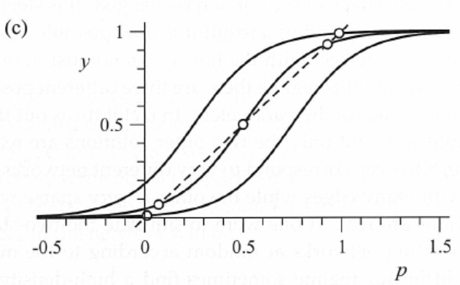
C=3/2 and three values of B
It is possible for suitable values of B that the curve has three intersections with y=p

Slide 34
Spontaneous symmetry breaking
The middle solution is unphysical and only the two outer solutions are realized in practice
These two correspond to very different networks
  One has very high density while the other is very sparse
  If one were to simulate the two-star model, one would in this regime sometimes find a high-density network and sometimes a sparse network
    One would not be able to predict which would occur
This peculiar behavior is called spontaneous symmetry breaking
  Condensed matter physics and particle physics

Slide 35
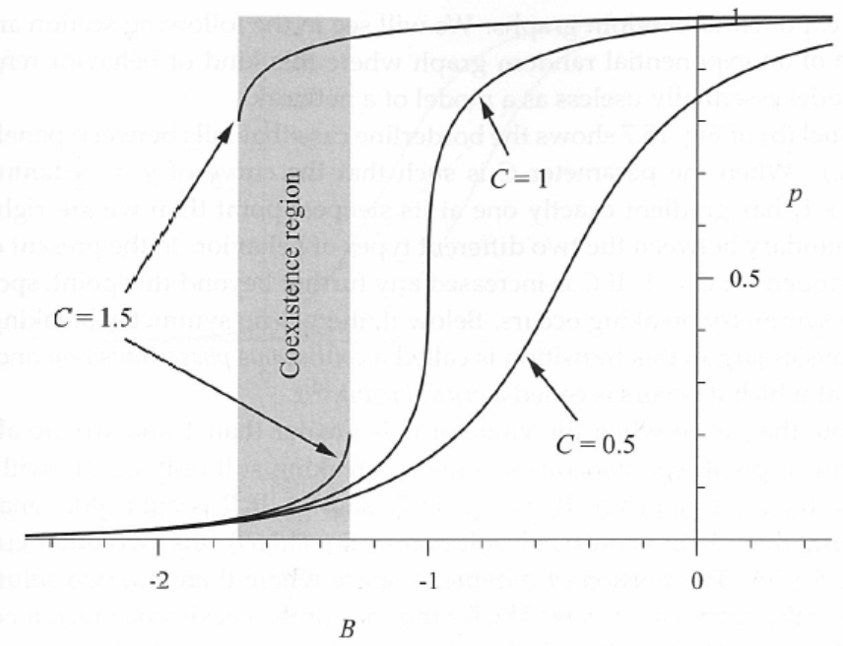

Slide 36
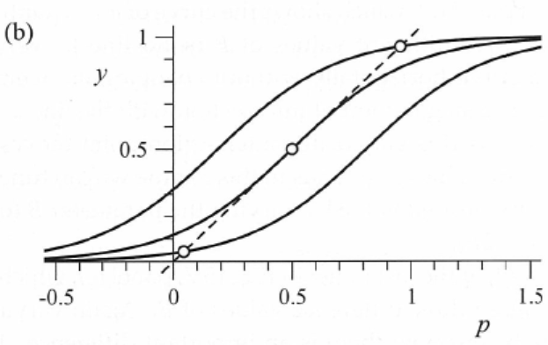
Critical point
Continuous phase transition: Below a critical point, there is no symmetry breaking
C=1

Slide 37
Note that even when we are above the critical point, spontaneous symmetry breaking still only occurs within a certain range of B
  If B is either too small or too large, there is only one solution
The portion of parameter space for B where there are two solutions is called the coexistence region

Slide 38
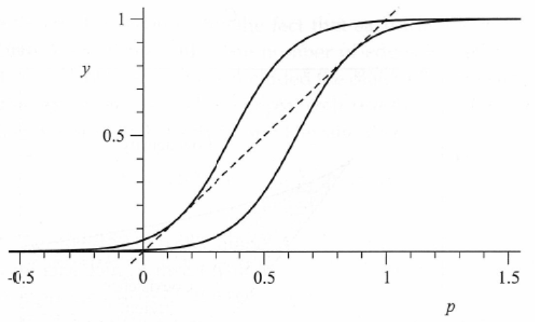
The boundaries of the coexistence region correspond to the values of B such that the curve is tangent to the line y=p

Slide 39





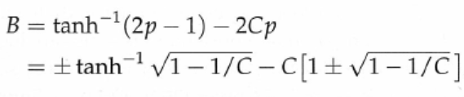
The gradient of is
Setting this to one and using sech² x=1-tanh² x, we have
But, p satisfies , so

Slide 40
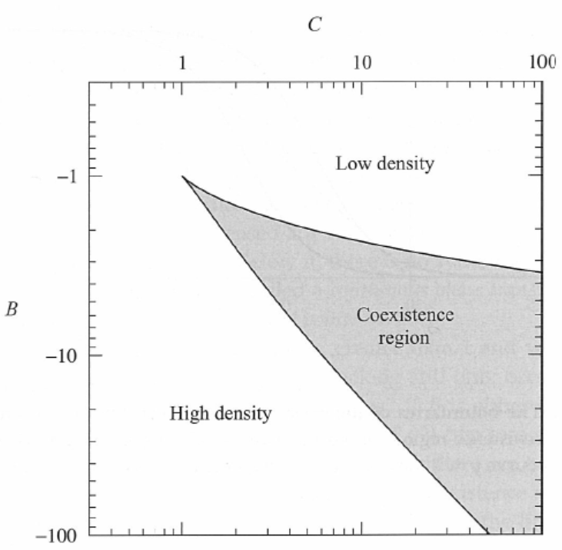

Slide 41


15.2.6 Strauss’s model of transitive networks
Strauss’s model is a simple undirected network that shows clustering or transitivity
The number of triangles is
Hamiltonian

Slide 42
Strauss’s model can be solved by using a mean-field technique
There is a phase transition beyond which the system develops a coexistence region where there are two distinct solutions to the equations
  Both are realized in simulations
  One solution corresponds to high density networks and the other a network of low density
  There is in this regime no choice of model parameters that will give networks of medium density

